Slide 1


Plant Kingdom
3
Introduction
Introduction
In the previous chapter, we looked at the broad classification of living organisms under the system proposed by Whittaker (1969) wherein he suggested the Five Kingdom classification viz. Monera, Protista, Fungi, Animalia and Plantae. In this chapter, we will deal in detail with further classification within Kingdom Plantae popularly known as the ‘plant kingdom’.
General Characteristics of Plants
Introduction
Plants are mainly autotrophs and photosynthetic
Plants are primarily multicellular except some algae
Plant growth is indeterminate
Plant defend themselves without moving
Classification of Plant kingdom
Introduction
Artificial System
1
Artificial System of classification is the earliest system of classification which was given by Linnaeus. This was based on the vegetative characters such as habitat, colour, size, shape, leaves, etc.
Vidyavantam - CBSE Class 11 Biology
1
Plant Kingdom

Slide 2
Drawbacks
The artificial systems don’t give anything about internal structure
The artificial systems gave equal weightage to vegetative and sexual characteristics; this is not acceptable since we know that often the vegetative characters are more easily affected by environment
Natural System
2
Natural System was given by George Bentham and Joseph Dalton Hooker. This system only consider external features, but also internal features, like ultrastructure, anatomy, embryology and phytochemistry.
Phylogenetic
3
This system is most acceptable system for nowadays. This system is based on evolutionary relationships between the various organisms are acceptable. This assumes that organisms belonging to the same taxa have a common ancestor. We now use information from many other sources too to help resolve difficulties in classification. We now use some other taxonomy if there is no fossils found which are :-
Numerical Taxonomy
Cytotaxonomy
Numerical Taxonomy
Numerical taxonomy is based on all the observable characteristics in microorganisms and each character is given equal weightage. Using computers, hundreds of characteristics can be considered simultaneously.
Cytotaxonomy
Cytotaxonomy refers to the classification of organisms based on their cellular structure such as chromosome number, structure, behaviour and chemotaxonomy that uses the chemical constituents of the plant to resolve confusions, are also used by taxonomists these days.
Vidyavantam - CBSE Class 11 Biology
2
Plant Kingdom

Slide 3
Algae
Plants
Introduction
Algae are the primitive type of plants, chlorophyll-bearing, simple, thalloid, autotrophic and largely aquatic.
Algae
Habitat
Bryophyta
1
Algae are mainly aquatic and can live in fresh water, marine and brackish water (both fresh and marine mix water).
Some of algae also occur in moist soil, moist stone, wood, lichens, sloth bear (trichophiles).
Algae can grows in salt pans(Halophytic alga).
Algae growing in snow are called Cryophytes.
Pteridophyte
Gymnosperms
Structure
2
Angiosperms
Algae are very simple, thalloid (don’t have roots, leaves, stems), mainly multicellular (can be unicellular) & eukaryotic and don’t have definite shape.
External Structure
Algae can be both multicellular and unicellular (e.g. Chlamydomonas) and vary in form and size. Multicellular algae can be found as filamentous, branched and colonial. Algae can be microscopic to 100m length brown algae.
Vidyavantam - CBSE Class 11 Biology
3
Plant Kingdom

Slide 4
Internal Structure or Cell detail
Algae can be classified into:-
Green algae (Chlorophyceae)
Brown algae (Phaeophycean)
Red algae (Rhodophyceae)
Now we will learn about cell organelles that is different in every type such as:-
1. Cell wall 2. Flagella 3. Pigment 4. Storage
Cell Wall
Algae contains cell wall which is made up of different chemicals
Green algae – Cellulose, pectin
Brown algae – Cellulose, algin
Red algae – Cellulose, carageen
In the outer layer of cell wall of brown and red algae contain chemical deposit that is used to hold water (hydrocolloids) e.g. algin (brown algae) and carrageen (red algae).
Flagella
Functions of flagella :–
Flagella facilitates movement and locomotion in organisms
Flagella can help detect changes in pH and temperature
They help eukaryotes to enhance their reproductive rates
They help in the identification of certain types of organisms
There are different type of flagella present in algae :-
Green algae Apical flagella with same height, 2 to 8 in number
Brown algae 2 Lateral unequal flagella
Red algae Flagella absent (non-motile)
-
-
-
Pigment
There are different kinds of pigment that are present in plastid of algae:-
Chlorophyll (Chlorophyll a, b, c, d)
Carotenoids (Carotin, Xanthophyll)
Different type of algae posses different pigments
Green algae – Chlorophyll a & b
Brown algae – Chlorophyll a & c, Fucoxanthin (brown in colour)
Red algae – Chlorophyll a & d, Phycoerythrin (red in colour)
Vidyavantam - CBSE Class 11 Biology
4
Plant Kingdom

Slide 5
Storage
All algae are autotrophs and make their food using the process of photosynthesis. Food is stored in different algae are:-
Green algae - Starch
Brown algae - Laminarian starch, Mannitol
Red algae - Floridian starch
Nutrition
3
All plants make their food by the process of photosynthesis which takes place in the presence of light in plastid where oxygen is the by-product (oxygenic photosynthesis).
Reproduction
4
The algae reproduce by three different methods, namely, vegetative reproduction, asexual reproduction and sexual reproduction.
Vegetative reproduction
In this type, any vegetative part of the thallus develops into new individual. It does not involve any spore formation and there is no alternation of generations. It is the most common method of reproduction in algae.
Cell division or fission
It is the simplest method of reproduction. The unicellular forms of algae commonly reproduce by this simple process, often called binary fission as found in Chlamydomonas, diatoms etc. In this method the vegetative cell divides mitotically into two daughter cells, those finally behave as new individual.
Fragmentation
Fragmentation is the process of breaking up of the body of an organism into two or more parts called fragments, each of which grows into a new individual. E.g. spirogyra, Ulothrix, etc.
Formation of Adventitious Branches
Various big thalloid algae create adventitious branches, that when detached from the body of the plant grow into new individuals. This type is seen in Fucus, Dictyota)
Vidyavantam - CBSE Class 11 Biology
5
Plant Kingdom

Slide 6
Budding
In Protosiphon bud-like struc­tures are formed due to proliferation of vesicles delimited from the parental body by a septum, which, after detach­ment, grow into a new plant.
Asexual reproduction
Asexual reproduction involves the formation of certain type of spores (either naked or freshly walled spores). It is a process of rejuvenation of the protoplast without any sexual fusion. Each and every spore germinates into a new plant. In this method, there is no alternation of genera­tions.
The asexual spores may be of various types:
Zoospores : Zoospores are formed within the zoosporangium and are motile exposed spores containing two, four, or several flagella, and are respectively referred to as bi-, quadri-, or multi flagellated zoospores. Biflagellate zoospores are found in Chlamydomonas, Ulothrix Ectocarpus etc., quadriflagellate zoos­pores are found in Ulothrix and multiflagellate zoospores are found in Oedogonium.
Each zoospore has a chloroplast and an eye spot. The zoospores may be are either haploid or diploid depending on the nature of plant body, gametophytic or sporophytic on which it develops.
The zoospores are liberated either by the disintegration of the zoosporangial wall or by the formation of an apical pore on the zoosporangium. After liberation the zoospores swim for a while, then with­draw their flagella, encyst and ulti­mately germinate into new plants.
Aplanospores : Aplanospores are non- motile spores. These spores are formed either singly or its protoplast may divide to form many aplanospores inside spo­rangium during unfavourable conditions, especially in drought (e.g., Ulothrix). The aplanospores may also be formed in certain algae of semiaquatic habitat.
When they appear identical to the parent cell, they are referred to as autospores (e.g., Scenedesmus, Chlorella etc.). Aplanospores with thickened wall and abundant food reserve are known as hypnospores (e.g., Pediastram, Sphaerella etc.).
They are formed to overcome prolonged period of desiccation. With the onset of favourable condition the hypnospores either directly germinate into a new individual or their protoplasts may form zoospores.
Sexual reproduction
Vidyavantam - CBSE Class 11 Biology
6
Plant Kingdom

Slide 7
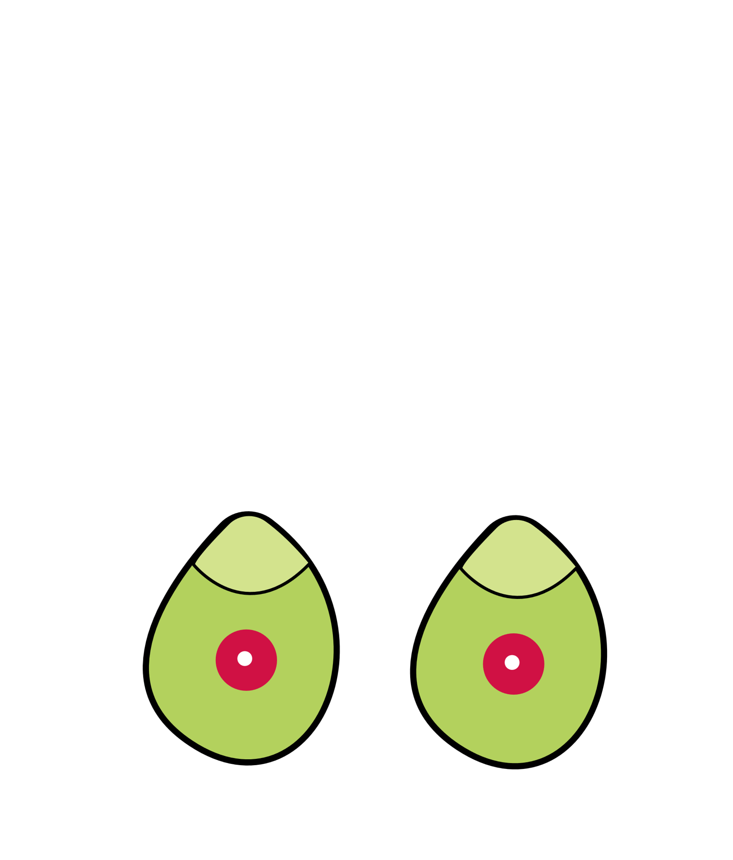
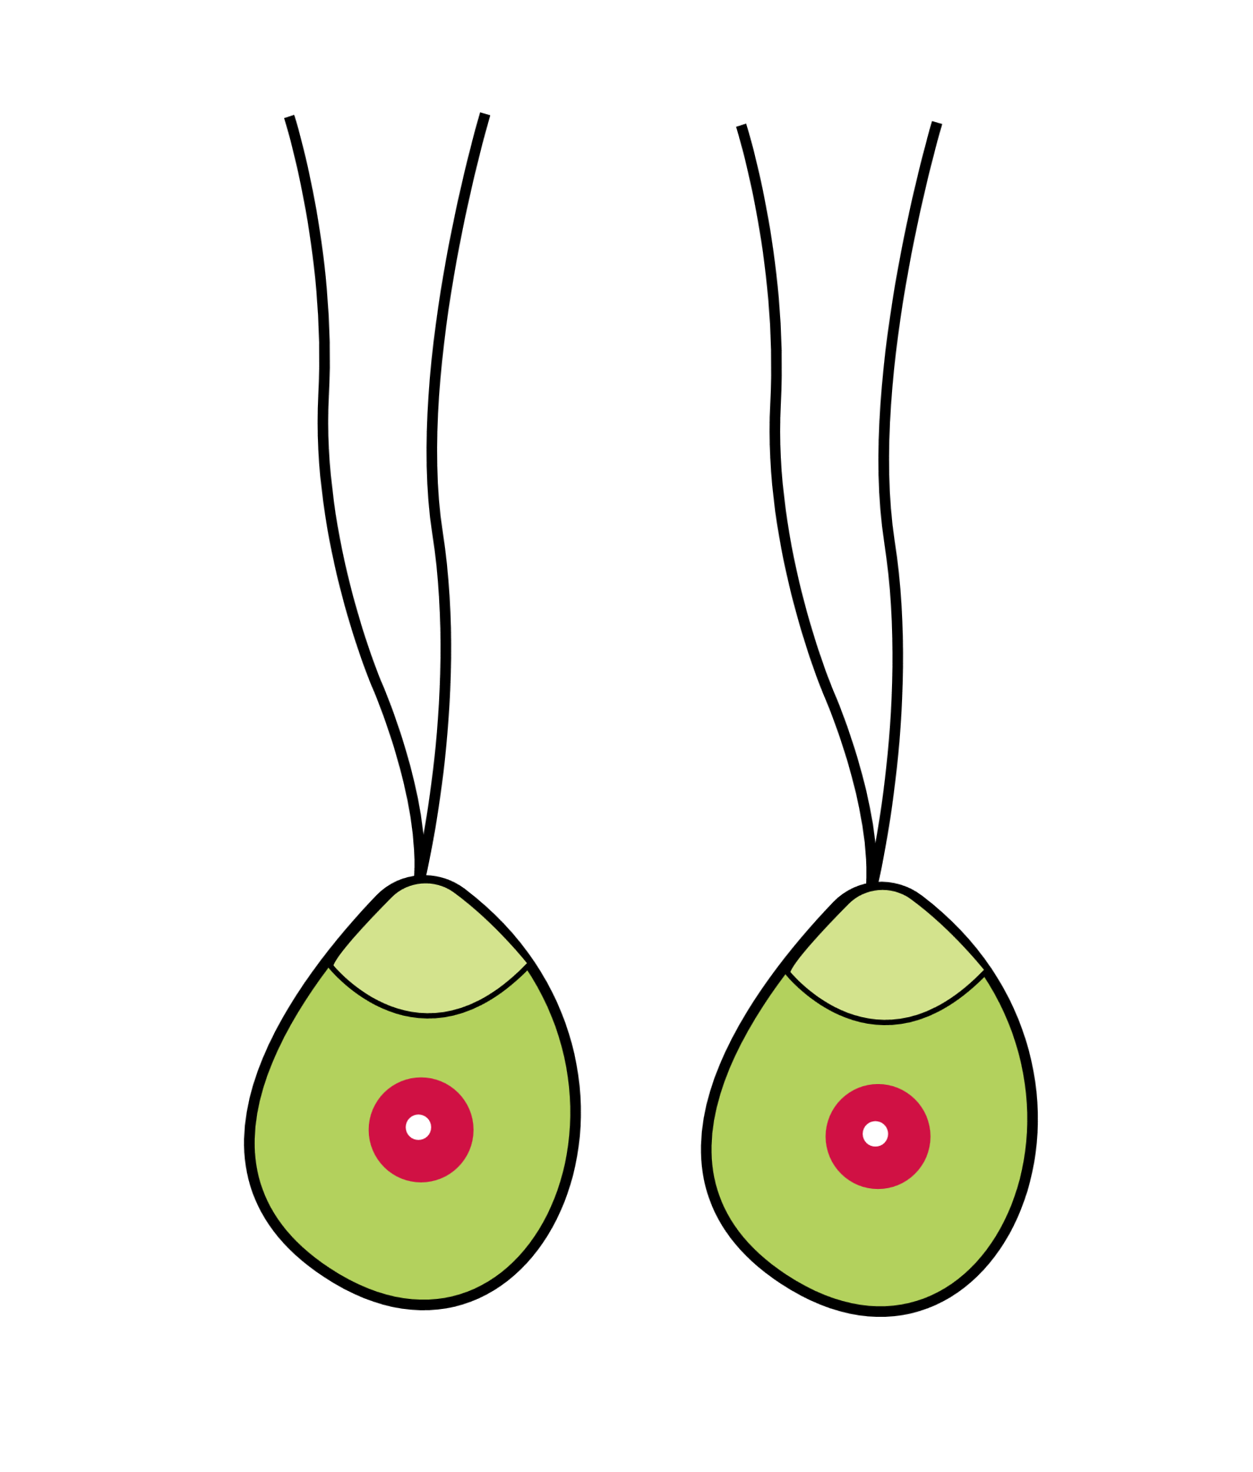
Sexual reproduction takes place by the fusion of the sexual reproductive units called gametes. Gametes are haploid structures and are formed in sac-like gametangia.
When male and female gametes are on the same thallus, the condition is called a homothallic stage. While male and female gametes are present on different thalli, the condition is called a heterothallic stage. The haploid gametes fertilise to form a diploid zygote.
On the basis of behaviour, function, and structure of gametes, sexual reproduction is of the following types:
Isogamy
This is a simple type of sexual reproduction in which fusing gametes are morphologically similar and are called isogametes.
Non-motile isogametes e.g. Spirogyra
Motile isogametes e.g. Chlamydomonas, Ulothrix, Cladophora, etc.
Heterogamy
It is bit advance type of sexual reproduction where tow (male and female) gametes differ both morphologically and physiologically. Male gametes are usually smaller in size. This kind of reproduction may be of two type – anisogamous and oogamous.
Anisogamous : Here both type of gametes are motile but male gametes are comparatively smaller in size and more active, e.g., Chlamydomonas braunii.
Vidyavantam - CBSE Class 11 Biology
7
Plant Kingdom

Slide 8
Oogamous : Being an advanced type of sexual reproduction, it is quite common among the higher algae. The male gametes are motile and are formed in large number whereas female gametes are non-motile and bigger in size, and produced few in number. Male gametes (the antherozoids) are produced in the antheridium (male reproductive bodes) where the female gamete, an or ovum, is produced in oogonium (female reproduction body). Some complex type of reproductive bodies found in Rhodophyceae are called spermatium and carpogonium, the male and female reproductive bodes, respectively.
Fertilisation in sexual reproduction
In isogamous and anisogamous types of sexual reproduction both gametes are first released from their respective gametangia and the fertilisation takes place outside gametangia, the process being called external fertilisation. In oogamous, the male gametes are liberated from male gametangium which swims to the oogonium. Fertilisation takes place inside the oogonium (internal fertilisation).
Zygote
The tow gametes after fusion form the zygote. Zygote being diploid cell represents the sporophytic phase of the life cycle. It may undergo a period of rest or may germinate immediately after fertilisation. In higher algae, e.g., members of Phaeophyceae, the gametophytic generation lasts for a short time. However, in majority of alae, the gametophytic phase is the dominant phase of the life cycle.
Germination of zygote
The germination of zygote may be of direct or indirect type.
Direct type : In such type of germination, the zygote after meiotic division develops directly into a new plant without producing any intermediate spore-like structure, e.g., Spirogyra.
Indirect germination : It may be of following two types:
Zygote divides meiotically and forms motile or non-motile haploid spores, of which each develops into a new plant, e.g., Chlamydomonas and Ulothrix
Zygote divides mitotically and forms a diploid plant. Later, plant reproduces by meiotic division and produces spores. Each spore develops into a new plant, e.g., Ectocarpus.
Classification of Algae
5
Vidyavantam - CBSE Class 11 Biology
8
Plant Kingdom

Slide 9
Harvey (1836), for the first time, divided algae into three groups:
Chlorospermae (green and fresh water forms)
Melanospermae (living)
Rhodospermae (small and red coloured forms)
Thereafter, Engler and Prantl (1912), in their publication Syllabus der Plflanzen familien, proposed an excellent system of classification of plant kingdom. They believed that the fungi have been derived from algae and, therefor, mixed the two as follow:
Schizophyta
Phytosarcodina
Flagellata
Dinoflagellata
Bacillariophyta
Conjugatae
West in 1916 attempted to classify algae on the basis of reproductive structures particularly on the presence of flagella and their nature and divided algae into:-
Isokotae (flagella of equal size)
Heterokontae (flagella of unequal size)
Stephanokotae (flagella crowned)
Akontae (flagella absent)
But Pascher (1931) laid stress on phylogeny and interrelationships of various groups. He divided alae directly into eight divisions as follows:-
Chrysophyta
Phaeophyta
Pyrrophyta
Euglenophyta
Chlorophyceae
Charophyta
Phaeophyceae
Rhodophyceae
Eumycetes (true fungi)
Chlorophyta
Charophyta
Rhodophyta
Cyanophyta
Chrysophyceae
Diatomae
Heterokotae
Chlorophyceae
Conjugatae
Charophyceae
Phaeophyceae
Bangiineae
Floridinae
Cryptophyceae
Desmokontae
Dinophyceae
Myxophyceae
Eugleninae
Soon after Pascher’s classification, Lady Tilden (1933) extended her views about algae classification and emphasised on certain fundamental criteria of classification, e.g., pigmentation, reserve food material, etc. She divided algae five classes:-
Chlorophyceae
Myxophyceae
Rhodophyceae
Phaeophyceae
Chrysophyceae
Vidyavantam - CBSE Class 11 Biology
9
Plant Kingdom

Slide 10
Fritsch (1935) in his book entitled The Structure and Reproduction of the Algae, has classified algae considering phylogeny, affinities and inter-relationships of various forms. In classifying algae he has taken a prenotion from the contribution of Pascher and to a certain Tilden. He has considered algae as one group equivalent to a division and has divided living forms of this group into 11 classes as follows.
Chlorophyceae
Xanthophyceae
Chrysophyceae
Bacillariophyceae
Cryptophyceae
Dinophyceae
Chloromonadineae
Euglenineae
Phaeophyceae
Rhodophyceae
Myxophyceae
Chlorophyceae (Grass-green)
The class Chlorophyceae is characterised by the members possessing grass-green chromatophores (also known as green algae). The other distinguishing features of the class are the presence of starch as reserve food material, pyrenoid, etc. which we will learn about these in this class.
Habitat
Free living fresh water forms - e.g., Members of Chaetophorales.
Attached fresh water forms - e.g., Members of Chaetophorales.
Floating fresh water forms - e.g. Members of Zygnemaceae, Oedogonium, Puhophora, etc. They may also grow as submerged masses.
Subaerial forms - e.g., Trentipohiia.
Forms growing attached on shells of molluscs – e.g. Cladophora and some members of Chaetophorales.
Epizoic forms – Some species of Characium grow on small Crustaceans and a few species of Chlamdomonas and Chlorangiopsis grow on tiny animalculae.
Space parasite – Chlorochytrium lemnae lives inside the tissue of Lemna (an angiosperm).
True parasite – Phyllobium sphagnicolum on the leaves of Sphagnum (bryophyte), Rhodochytrium spilanthidis on the leaves of Ambrasia and Cephaleuros on the leave of Thea, Piper and a number of other tropical trees.
Symbiotic forms – Trebauxia, Chlorella, Coccomyxa are known to live symbiotically with various fungi in lichens. Zoochlorella and Carteria are known to live symbiotically in association with Hydra and Convoluta (animals).
Marine forms – Most members of siphonales inhabit the sea, e.g. Bryopsis, Caulerpa, Acetabularia, Codium etc. The tow species of Ulothrix, Ulothrix facca and Ulothrix impexa are also marine.
Vidyavantam - CBSE Class 11 Biology
10
Plant Kingdom

Slide 11
External Structure
Colonial – e.g. – Volvox.
Filamentous – e.g. – Ulothrix, Spirogyra. Etc.
Internal Structure
Cell wall – Cell wall is made up of cellulose.
Flagella – Apical flagella with same height, 2 to 8 in number.
Storage – Starch and oil.
Pigment – The chief pigments are chlorophyll a and b and two yellow pigments (carotenoids). Thus chromatophores are grass-green in colour.
Pyrenoids
Most of the members of Chlorophyceae class possess one or more pyrenoids in plastid which are nothing but storage bodies seen in chloroplasts. Pyrenoids contain protein besides starch.
Reproduction
Vegetative – Fragmentation
Asexual – Zoospores
Sexual – Isogamous, Anisogamous, Oogamous
Classification of Chlorophyceae
Fritsch (1935) divided class Chlorophyceae into 9 orders, their brief characters are discussed here.
Order 1 Volvocales –
The forms are unicellular and colonial.
They remain motile throughout their life.
They are mainly fresh water forms.
They reproduce both sexually and asexually. Asexual reproduction takes place by zoospo­res, aplanospores, etc. and sex­ual reproduction is takes place by isogamy, anisogamy and oogamy.
The order Volvocales is divided into three sub-orders - Chlamydomonadaceae, Tetrasporineae and Chlorodendrineae.
Common examples – Sphaerella, Volvox, Gonium, Pandorina, Chlamydomonas, etcetera.
Order 2 Chlorococcales –
The forms are unicellular to colonial.
They are non-motile.
Vegetative reproduction is absent.
They occur as planktonic or terrestrial forms.
The order is divided into eight families - .
Common examples – Pediastrum, Hydrodictyon, etcetera.
Vidyavantam - CBSE Class 11 Biology
11
Plant Kingdom

Slide 12
Order 3 Ulotrichales –
The plant body consists of a simple, unbranched filament.
Most of the forms are fresh water.
Most forms have single parietal band-shaped chloroplast, each with several pyrenoids.
The order is divided into tow sub-orders – Ulotrichineae and Prasiolineae
The order is divided into four families – Ulotrichaceae, Microsporaceae, Cylinrocapsaceae and Ulvaceae.
Common examples – Ulothrix, Hormidium, Enteromorpha, Monostroma, Ulva, etcetera.
Order 4 Cladophorales –
The plant body consists of branched filaments.
Most of the forms occur in fresh water.
Cells are cylindrical. Each cell is uninucleate (single nucleus) with a reticulate chloroplast.
Families – Cladophoraceae.
Common examples – Cladophora, Pithophora, etcetera.
Order 5 Chaetophorales –
The plant body consists of branched.
Apical cell of the filament is sharply pointed.
Most of the forms occur in fresh water.
Families – Chaetophoraceae, Trentipohliaceae, Coleochaetaceae, Chaetosphaeridiaceae and Pleurococcaceae.
Common examples – Coleochaete, Stigeoclonium, Draparnaldia, Draparnaldiopsis, etcetera.
Order 6 Oedogoniales –
The plant body is unbranched and filamentous.
Sexual reproduction is advanced oogamous type.
Most of the forms are fresh water.
Families – Oedogoniaceae.
Order 7 Conjugales –
The plant body is simple filamentous.
No phase is motile in life cycle
Most of the forms occur in fresh water.
Families – Euconjugatae and Desmidiaceae.
Common examples – Debarya, Zygnema and Spirogyra.
Order 8 Siphonales–
The plant body is filamentous.
Most of the forms occur in marine water except few.
Families – Protosiphonaceae, Caulerpaceae, Dasycladaceae, Derbesiaceae, Codiaceae, Valoniaceae, Chaetosiphonaceae, Phyllosiphonaceae and Vaucheriaceae.
Vidyavantam - CBSE Class 11 Biology
12
Plant Kingdom

Slide 13
Common examples – Vaucheriopsis and Vaucheria (Now Vaucheria is described under Xanthophyceae).
Order 9 Charales–
Plants are macroscopic, much branched, and erect and commonly up to 30 cm in length.
The plants are differentiated into nodes and internodes. Some of the nodes bear bran­ches of unlimited growth, those are again divided into nodes and internodes. Each node of the main axis and branch of unlimi­ted growth bear a number of branches of limited growth.
Sexual reproduction is highly advanced, oogamous type.
Families – Characeae which is further divided into two sub-families:-.
Nitellaceae – examples – Nitella, Tolypella
Chareae – examples – Chara, Lychnothamnus
Xanthophyceae (Yellow-green)
Allore (1930) proposed the name Xanthophyceae to the Heterokontae of Chlorophyceae (bearing unequal flagella), which was subsequently widely adopted. Unlike other classes, Xanthophyceae are not well studied and therefore, the class is characterised only on the basis of chromoplast pigmentation, flagellation and reserve food material
Habitat
Members of Xanthophyceae are commonly fresh water (Tribonema) and most of them are free floating. [Few members are found to grow on mud (Botrydium) and also on walls or tree trunks (Characiopsis, Ophiocytium etc.). A few members like Halosphaera are marine.
Internal Structure
Cell wall – The cell wall is often absent, but when pre­sent it contains more pectic compounds than the members of Chlorophyceae. Occasionally cellulose is also present.
Flagella – The motile forms bear usually two flagella but rarely one. They are unequal and inser­ted at the anterior end. The flagella are of two types. The larger one is tinsel (or pantonematic or pleuronematic i.e., bearing hair-like appendages) and the shorter one is whiplash (or acronematic i.e., without hairs and their surface is smooth) type.
Storage – The reserve food is oil, lipid and lucosin. Starch is not formed.
Pigment – Yellow green colour of algae is due to their parietal chromatophores which have a combination of Chlorophyll a and e, β-carotene and several Xanthophylls and Chlorophyll c is observed in Vaucheria and in few members of Botrydiales.
Pyrenoids – Absent, rarely present.
Vidyavantam - CBSE Class 11 Biology
13
Plant Kingdom

Slide 14
Reproduction
Vegetative – Budding
Asexual – Aplanospores, zoospores (unequal flagella except Vaucheria)
Sexual – Isogamous (Tribonema), Anisogamous (Botrydium), Oogamous (Vaucheria)
Classification of Xanthophyceae
Xanthophyceae is divided into 4 orders, their brief characters are discussed here.
Order 1 Heterochloridales –
The plant body is flagellated, naked and unicellular.
Each cell contains two or more discoid or band-shaped chromatophores and one or more contractile vacuoles in the protoplast.
Reproduction takes place by cell division and in one genus statospores are formed.
There are 9 genera and about 15 species; 4 genera are marine and rest are fresh water in habit.
Common examples – Heterochloris, Chloramoeba.
Order 2 Heterococcales –
They are non-filamentous and incapable of returning directly to a motile form.
The plant body consists of coccoid or colonial (gelatinous) forms.
Reproduction takes place by means of zoospores and aplanospores. The aplanospores are autospores. They have no capacity of vegetative cell division.
There are 45 genera, and about 270 species. All are fresh water in habit.
Common examples – Myxochloris, Botrydiopsis.
Order 3 Heterotrichales –
The plant body is simple or branched filament.
Reproduction takes place by means of fragmentation, akinetes, zoospores, aplanospores and hypnospores.
Physiological isogamy is found in one genus, i.e., Tribonema.
There are 8 genera and about 35 species. All are fresh water in habit.
Common examples – Tribonema.
Order 4 Heterosiphonales –
The plant body is simple or branched filament.
Reproduction takes place by means of fragmentation, akinetes, zoospores, aplanospores, hypnospores, isogamous.
Physiological isogamy is found in one genus, i.e., Tribonema.
There are 8 genera and about 35 species. All are fresh water in habit.
Common examples – Botrydium and Vaucheria.
Vidyavantam - CBSE Class 11 Biology
14
Plant Kingdom

Slide 15
Chrysophyceae (Brown or orange)
Habitat - Most forms occur in cold fresh water but a few are marine.
Structure – Plants are unicellular motile to branched filamentous.
Cell wall - The cell wall is calcified and non cellulosic.
Flagella - The motile cell have two anteriorly inserted unequal flagella.
Storage – The food reserve is chrysolaminarin and leucosin.
Pigment – Phycochrysin is the dominant pigment which imparts brown or orange colour to these algae.
Pyrenoids – The chromatophores have naked pyrenoid like bodies.
Sexual Reproduction -Sexual reproduction is very rare when present it is isogamous type.
Orders - Chrysomonadales (e.g., Chrysodendron), Chrysosphaerales (e.g, Chrysosphaera), Chrysotrichales (Chrysoclonium).
Bacillariophyceae (Yellow or golden brown)
Habitat - Most forms occur in cold fresh water but a few are marine.
Structure – Plants are unicellular motile to branched filamentous.
Cell wall - The cell wall is calcified and non cellulosic.
Flagella - The motile cell have two anteriorly inserted unequal flagella.
Storage – The food reserve is chrysolaminarin and leucosin.
Pigment – Phycochrysin is the dominant pigment which imparts brown or orange colour to these algae.
Pyrenoids – The chromatophores have naked pyrenoid like bodies.
Sexual Reproduction -Sexual reproduction is very rare when present it is isogamous type.
Orders - Chrysomonadales (e.g., Chrysodendron), Chrysosphaerales (e.g, Chrysosphaera), Chrysotrichales (Chrysoclonium).
Cryptophyceae (Nearly Brown)
Habitat – both in fresh and marine water.
Flagella - The motile cell have two slightly unequal flagella.
Storage – The food reserve is solid carbohydrates.
Pigment – chlorophylls a and c, together with phycobiliproteins and other pigments
Pyrenoids – The chromatophores have naked pyrenoid like bodies.
Sexual Reproduction - Sexual reproduction is rare and of isogamous type.
Orders - Crptomonadales (e.g., Cryptomonas), Cryptococcales (e.g.,Tetragonidium)
Vidyavantam - CBSE Class 11 Biology
15
Plant Kingdom

Slide 16
Dinophyceae (Dark yellow or brown)
Habitat – Plants occur widely as sea water planktons. A few may be fresh water forms.
Structure – Plants are unicellular motile to branched filamentous.
Flagella - Most of the cells of this class are motile unicells with two flagella.
Storage – The food reserve are starch and fat.
Pigment – The main pigment is xanthophyll which imparts brown or red colour.
Sexual Reproduction - Sexual reproduction is absent.
Orders - This class includes six orders.
Euglenineae (Pure green)
Habitat – Plants occur only fresh water.
Structure – Plants are unicellular. Pyrenoid like bodies are present in some forms.
Flagella - Most of the members have one or two flagella which arise from base of a canal like invagination at the anterior end.
Storage – The reserve food is a polysaccharide paramylon, related to starch, and fats.
Pigment – chlorophyll a and b, (β-carotenes, xanthophyll).
Sexual Reproduction - Sexual reproduction is not substantially known and is of isogamous type.
Phaeophyceae (Brown)
The brown algae which is structurally most complex algae are characterised by the presence of golden brown xanthophyll pigment, fucoxanthin imparting a colour variation from olive green through light golden to dark brown. The other accessory pigments are chlorophyll a, chlorophyll c, β and C-carotenes and other xanthophylls. The pigment locates in chromatophores. Naked pyrenoids are present only in primitive forms. The reserve photosynthetic products are laminarin and mannitol and rarely some fats. Laminarin, however, predominates. They occur from simple filaments to massive plant bodies.
Habitat
The main habitat of brown algae is marine water. Only three genera Pleurocladia, Bodanella and Heribandiella have been reported to grow in fresh water. Some other forms are also reported to grow in brackish water.
Vidyavantam - CBSE Class 11 Biology
16
Plant Kingdom

Slide 17
Internal Structure
Cell wall – it consists of two layers. The inner layer consists of cellulose with molecules arranged in the form of parallel microfibrils. It contains glucose and xylose as sub-units. The outer layer is gelatinous and is composed of pectic substance. In majority of forms the outer layer shows the presence of certain colloidal substances like algin and fucoidan. These compounds chiefly dominate in Laminaria, Sargassum and Ascophyllum and are of great economic importance. These compounds are much helpful to plants as they absorb water (hydrocolloids) and help the plants to pass over desiccation period.
Flagella – 2 lateral and unequal flagella.
Storage – Reserve food in the form of laminarin (polysaccharide) and mannitol (form of alcohol).
Pigment – Pigments include chlorophyll a and c, β-carotene. Chromatophores besides other pigments contain fucoxanthin.
Reproduction
Vegetative – Fragmentation
Asexual – Zoospores (lateral flagella)
Sexual – Isogamous, Anisogamous, Oogamous (e.g. fucus)
Classification of Phaeophyceae
Fritsch (1945) divided class Phaeophyceae into 9 orders:-
Ectocarpales (e.g. Ectocarpous)
Tilopteridales (e.g. Tilopteris)
Cutleriales (e.g. Cutleria)
Sporochnales (e.g. Sporochnus)
Desmarestiales (e.g. Desmarestia)
Laminariales (e.g. Laminaria, Macrocystis)
Sphacelariales (e.g. Sphacelaria, Haploteris)
Dictyotales (e.g. Dictyota)
Fucales (e.g. Fucus, Sargassum)
Rhodophyceae (Red)
A fairly large and distinct group, The Rhodophyceae, comprises of nearly 25,000 species grouped under 400 genera. The group is popularly called red algae and is characterised by following features:
Red colour of plant is due to presence of two phycobilin pigments (phycoerythrin and phycocyanin). The red pigments mask the presence of other pigments
Floridean starch and galactoside floridosides are the reserve foods.
Polysulphate esters are the characteristic pigments of the cell wall
Vidyavantam - CBSE Class 11 Biology
17
Plant Kingdom

Slide 18
Sexual reproduction is highly specialised but fairly uniform. The male gametes called spermatia are non-motile and the female reproductive organ is called carpogonium.
The motile stage are invariably absent
There are well elaborated post-fertilisation developments, not seen in any other group of algae.
Habitat
Most of the forms are marine except the various species of Batrachospermum and Lemanea which inhabit fresh water. Although showing world wide distribution, the red algae occur largely in the warmer seas, light plays and important role in the ecological distribution of sublittoral marine algae. Only bule and red light penetrate to deeper levels in water and beyond ten metres only blue-green light remains available which ocean efficiently be absorbed by r-phycoerythrin pigment. It is one reason that red algae can grow at the depth of sixty metres where only particular pigment remains capable to carry on photosynthesis.
Internal Structure
Cell wall – Inner layer of cell wall consist of microfibrillar cellulosic layer and an outer layer consist of pectin along with Polysulphate esters.
Flagella – Absent (non-motile)
Storage – The food reserve in the form of Floridean starch (a polysaccharide)
Pigment – The various pigments present in chromatophores are – Chlorophylls a and d, Carotenes (β-carotene, e-carotene), Xanthophylls (e.g. Fucoxanthin). Besides other pigments chromatophores contain r-phycoerythrin and r-phycocyanin which impart red colour to these algae.
Reproduction
Vegetative reproduction is uncommon in red algae except in unicellular forms, whereas asexual and sexual reproduction are quite common.
Vegetative – Fragmentation
Asexual – Aplanospores (non-motile)
Sexual – Oogamous only
Classification of Rhodophyceae
Rhodophyceae is classified into 7 orders:
Bangiales (e.g., Bangia, Porphyra, Porphyridium)
Nemalionales (e.g., Batrachospermum, Nemalion)
Gelidiales ( e.g., Gelidium)
Cryptonemiales (e.g., Corallina)
Gigartinales (e.g., Gigartina, Gracilaria )
Vidyavantam - CBSE Class 11 Biology
18
Plant Kingdom

Slide 19
Rhodymeniales ( e.g., Champia, Rhodymenia)
Ceramiales ( e.g., Ceramium, Polysiphonia)
Myxophyceae (Cyanophyceae or blue-green algae)
The algae are characterized by the presence of very rudimentary nucleus and they do not have well organized chromatophores (i.e. cell organization is prokaryotic).
Habitat – Plants occur in sea and fresh water.
Structure – Plants are simple type of cell to filamentous, some of the filamentous forms show false or true branching.
Flagella – No motile stages is known.
Storage – The food reserve is cyanophycean starch.
Pigment – The chief pigment is chlorophyll a, β-carotene and c phycocyanin.
Sexual Reproduction - Sexual reproduction is absent.
Orders - This class includes 5 orders.
Economic importance
6
Algae as food – Around 70 species are found to be edible
Algae in industries -
Vidyavantam - CBSE Class 11 Biology
19
Plant Kingdom

